Slide 1
ML @ E- Recruitment
Problem Statement:
One of the biggest challenges facing HR professionals today is finding the best talent to hire. This task has proven burdensome in the past, in part due to inefficient manual tasks that plague the recruiting process and the lack of access to the right data to make informed decisions. In fact, per research conducted by LinkedIn, 46% of recruiters and hiring managers have identified "finding the right candidate" as the biggest hurdle in hiring today. To tackle these challenges, new technology companies are rapidly emerging in the HR tech ecosystem with robust solutions that use Big Data, predictive analytics, and AI to automate and improve everything in the recruitment process from job advertising and resume screening to applicant engagement, scheduling, and recruiting by text. These new tools offer us ways to help overcome the limitations and biases inherent in recruiting with automated processes that are hyper-responsive to market data, complex metrics, and even budget constraints.
Hence this project is to find out on very fist problem, where we would like to find out a solution to match job requisition with candidate’s resume.
Solution: Our approach was two-fold similarity & relevance i.e.
Finding similarities between Job description & resume.
Finding the relevance between JD & Resume by abstraction

Slide 2
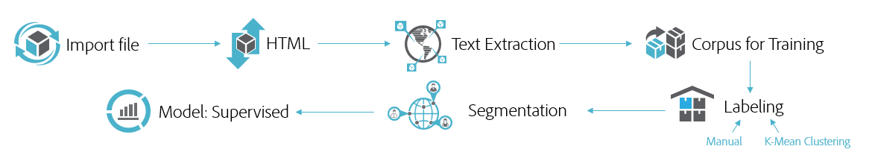
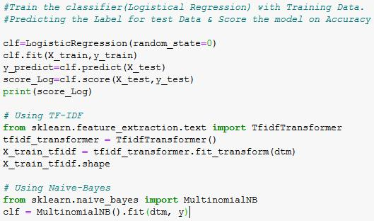
Steps for corpus cleaning and predictive modeling
Text classifier from training data (Logistic regression, TF-IDF, Multinomial Naïve Bayes)

Slide 3
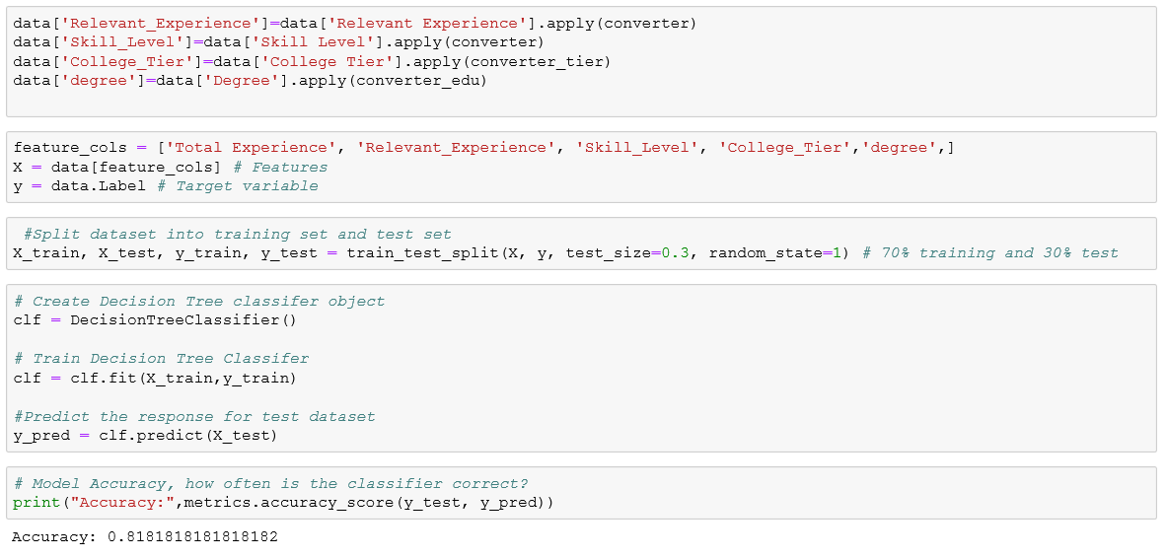
Feature collection and running supervised model for prediction

